Slide 1

Private Residential Property Transaction in Singapore
Student name: Chow Hooi Koon
https://github.com/HelenChow22/mages_project

Slide 2
Introduction:
Understanding the transaction to choose where to purchase your private residential property, which depending to your purpose and budget.

Slide 3
Dataset resource:
URA website
https://www.ura.gov.sg/realEstateIIWeb/transaction/search.action
https://www.ura.gov.sg/maps/api/#private-residential-property-transactions
The dataset will show the transactions of private residential property transaction in Singapore from a predetermined range of dates, giving clear insights into some of the important aspect in terms of prices, dates purchase, district etc.
** This URA data shows lastest 60 months transaction (5 years) only.

Slide 4
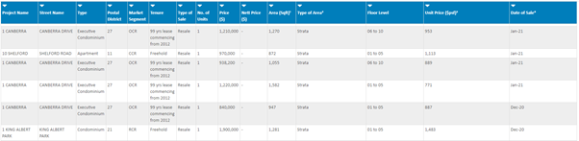
Example:

Slide 5
From here we will have the:
Project name of the property – a very specific attribute on the location, could be a specification on outliers, e.g. a ultra-expensive project compared to its peers in the same postal district.
Street name – a broader look on the project, can be used to gauge for an expensive street among the postal districts.
Type of property – important classification among condominiums, apartment, EC etc.
Postal District – an important criterion on location which determine prices.
Market Segment (CCR/RCR/OCR) – an even broader terms on location use for a quick broad view of the different Segment for quick analysis on the market demand.
CCR = Core Central Region
RCR = Rest of Central Region
OCR = Outside of Central Region

Slide 6
Tenure of the property – freehold or 99 years, important criteria when pertaining to the depreciation of the property value with reference to legal ownership = $0 when tenure date left = 0 years
Type of sale (New/Sub or Resale) – helps to categories according to market demands.
Number of unit – Total how many unit was sold.
Price of transaction – the sold of the property.
Area (Sqft) – Area of the property which helps to make sense of the price of transaction.

Slide 7
Type of area – Strata, Landed.
Floor level – another small criterion on the property pricing where higher level usually meant a higher price.
Unit price (PSF) – an important criterion on pricing which is more suitable as a mean of comparison among the properties.
Date of sale – can be used to read trend of the market.
There is almost no restriction in the size of the dataset that we can extract, only constraint is that the extraction will be split into 4 batches in accordance to the postal district.

Slide 8
Challenge
Absence on the date of TOP for the project (freehold properties) as well as the relevant age of the property when sold each time. Common assumptions now are that property prices will have an appreciating value accordance to time due to inflation, demand etc, until a point when the depreciating tenure cost exceeds the appreciation, resulting in the downward trend of the property.
Important of TOP (Freehold & 99 years):
- chances to en bloc,
- when can move in
- when can start to rent out
- when can resale
This challenge should be able to be overcome by doing research on the property name and adding 2 more columns on the data: “date of TOP” and “Remaining lease”.

Slide 9
Some questions that we will want to find answers with the dataset.
Transaction units between market segments.
Growth of sales among the 3 market segments in the past 5 years.
Floor area (sqft) vs transaction price in 3 different market segments.
Floor area PSF (per sqft) vs transaction price.
Average transaction price within CCR.
The relationship between floor level and transaction price within CCR.
Which project has the highest and lowest transaction price in CCR?
Which project has the highest and lowest PSF in CCR?

Slide 10
What is CCR, RCR and OCR?
The Urban Redevelopment Authority (URA) has divided Singapore into three main regions, which the URA calls "market segments".
These regions are: Core Central Region (CCR), Rest of Central Region (RCR) and the Outside Central Region (OCR).
Core Central Region (CCR): postal district 9,10,11 and parts of 1,2,4,6,7
Rest of Central Region (RCR): postal district 3,8,12 and parts of 1,2,4,5,6,7,13,14,15 and 20.
Outside Central Region (OCR): postal district 16 to 19,22,23,25 to 28 and parts of 5,14,15 and 20.

Slide 11
Data clarification
CCR - 3 postal district of 9, 10 and 11.
RCR - 3 postal district of 3, 8 and 12.
OCR - 3 postal district of 16, 17 and 18.
District area
District 9 - Orchard, Somerset, River Valley.
District 10 - Tanglin, Bukit Timah, Holland.
District 11 - Newton, Novena, Duearn, Wattern.
District 3 - Queenstown, Alexandra, Tiong Bahru.
District 8 - Little India, Ferrer Park.
District 12 - Balestier, Whampoa, Toa Payoh, Boon Keng, Bendemeer, Kampong Bugis.
District 16 - Bedok, Upper East Coast, Bayshore, Tanah Merah, Upper Changi.
District 17 - Flora Drive, Loyang, Changi.
District 18 - Tampines, Pasir Ris.
Data period
It shows latest 60 months transaction.
Building type
Apartments and condominiums only.
Transaction type
Transaction included new sale, resale and subsale.

Slide 12
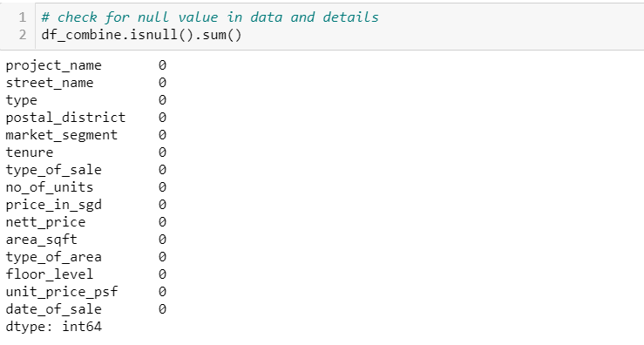

Slide 13
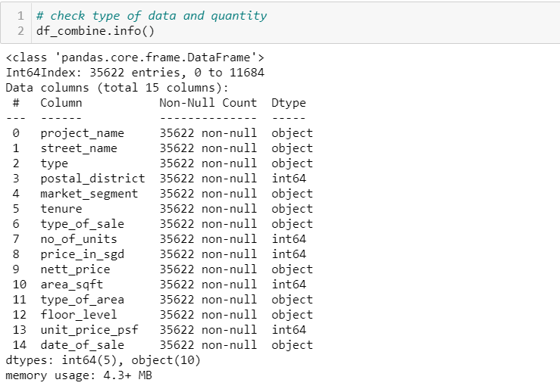

Slide 14
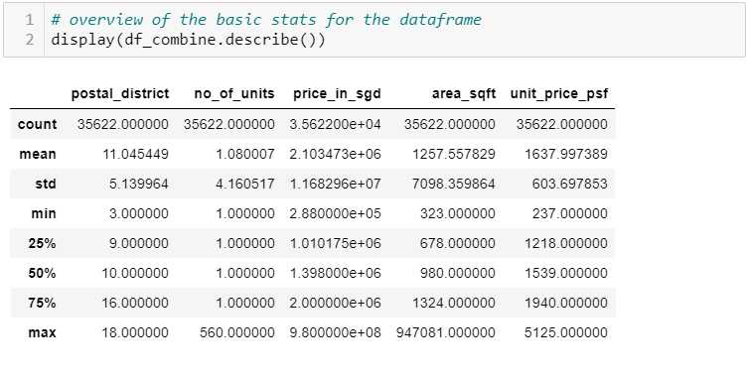

Slide 15
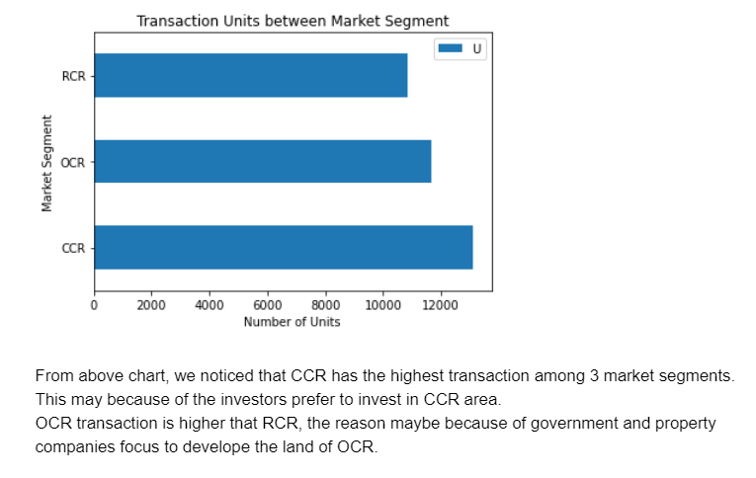
Transaction units between market segments.

Slide 16
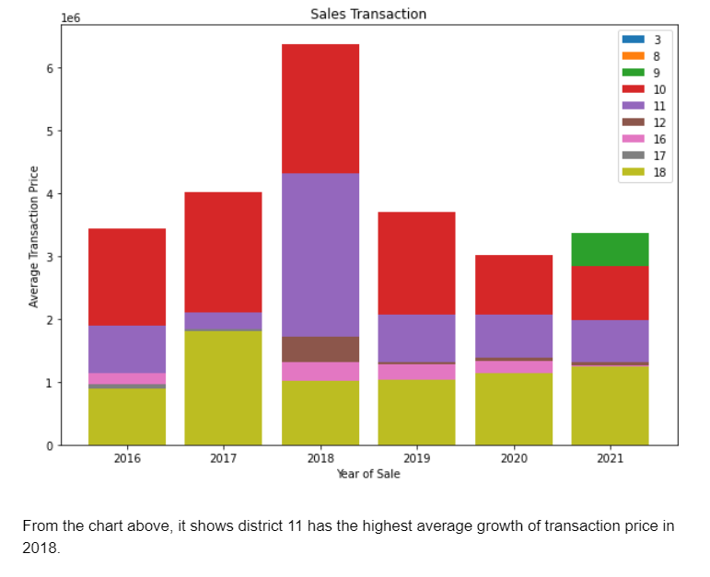
Growth of sales among the 3 market segments in the past 5 years.

Slide 17
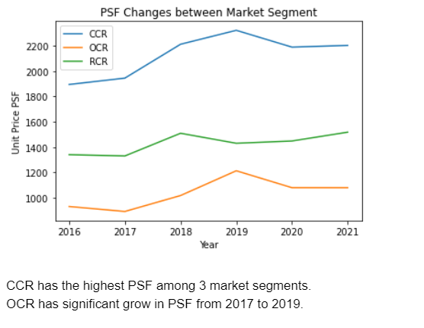
Floor area PSF (per sqft) vs transaction price.

Slide 18
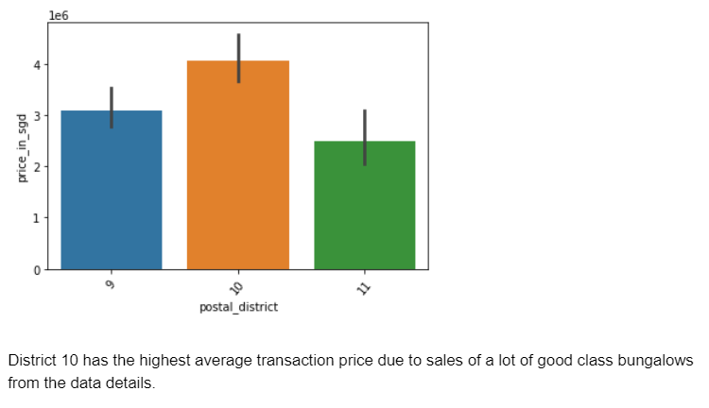
Average transaction price within CCR.

Slide 19
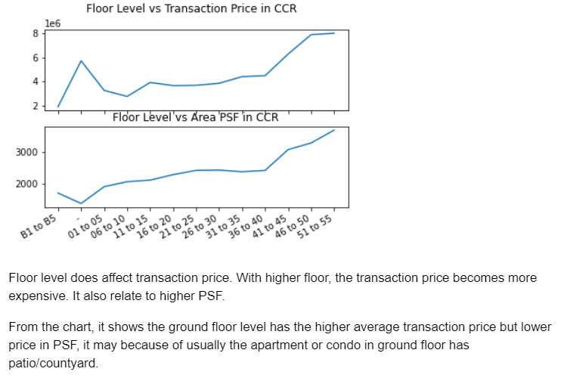
The relationship between floor level and transaction price within CCR.

Slide 20

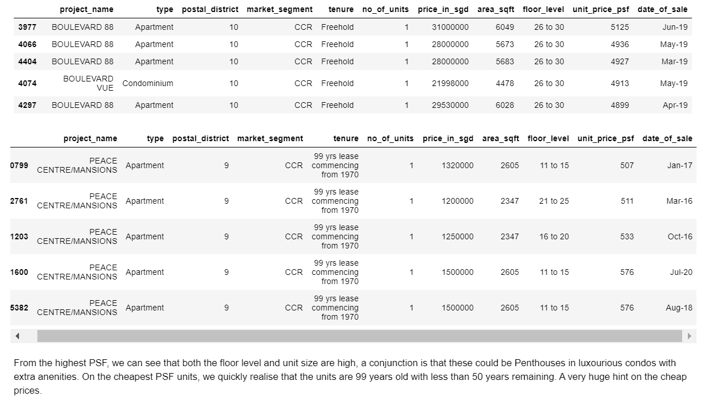
Which project has the highest and lowest PSF in CCR?

Slide 21
Conclusion
With these data sets, we can zoom into different district, street name, or project to look for your preferrable private property.
https://github.com/HelenChow22/mages_project

Slide 22
Thank you

